Slide 1

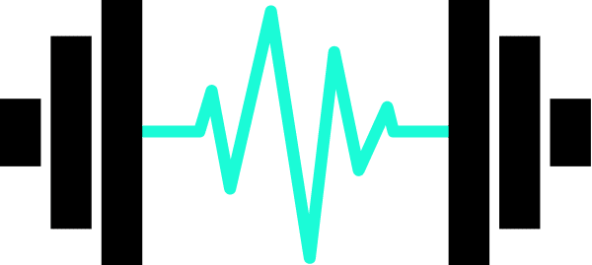
INSTITUTO SUPERIOR DE ENGENHARIA DE LISBOA Departamento de Engenharia Eletrónica e Telecomunicações e Computadores
Intelligent Sports Weights
TFM11 - Dissertação de Mestrado 2023/2024
Olga dos Santos Duarte, Nº 27675
Notes:
Falar mais do TinyML
15min de apresentação

Slide 2
Presentation Outline
Introduction & Motivation
03
Objectives
04
Related Works on Movement Recognition
05
Solution Outline
06
Low and No Code Platforms to train NN
09
Relevant Technologies on Movement Recognition
10
Ultra Low Power Embedded System
11
Preliminary Results
12
Work Plan
15
Known Challenges and Limitations & Conclusions
16
Notes:
Related works on...
Platforms type (embebeded system platforms)
Relevant Tecnologies
System architecture - (software) - solution proposal

Slide 3
Introduction & Motivation
Build an embedded system in a microcontroller with a trained Neural Network, using TinyML.
Use of low code or no code platform.
Program a neural network on low power microcontroller.
01
02
03
Safe Physical Exercise
Embedded Systems
Real time feedback
Identify the correctness of fitness exercises to avoid injury.
Autonomous, low-power, small size
Sensors in gym equipment to provide feedback.
Notes:
After feeling comfortable with the results,
Descomplicar - no máximo colocar um 1,2 e 3
Build -> program/develop
Bullets:
Program a neural network on low power microcontroller
Low code
Este microcontrolador tem uma plataforma estilo no code que permite treinar uma rede neuronal e fazer o deployment diretamente no micro. Para ter uma experiência rápida de treino de rede, como é adeuqação com o nosso problema. Exploração da plataforma.​
Após ganhar confiança com a rede.​
Depois vamos fazer a aquisição de dados, temos uma rede implementada - o esqueleto – que será implementada em software. Para permitir fazer optimizações que a plataforma no code não irá permitir.​
​
Uma abordagem top-down.​
Ter a ferramenta da plataforma para agilizar a explicação do modelo da rede neuronal​
Depois "olear" isto desenvolvendo em software, começar por detectar movimentos numa rede já treinada - depois explorar nos movimentos aliados ao desporto.​
​
Edge impulse configuramos, mas não conseguimos optimizar –> procurar "comprovativo"

Slide 4
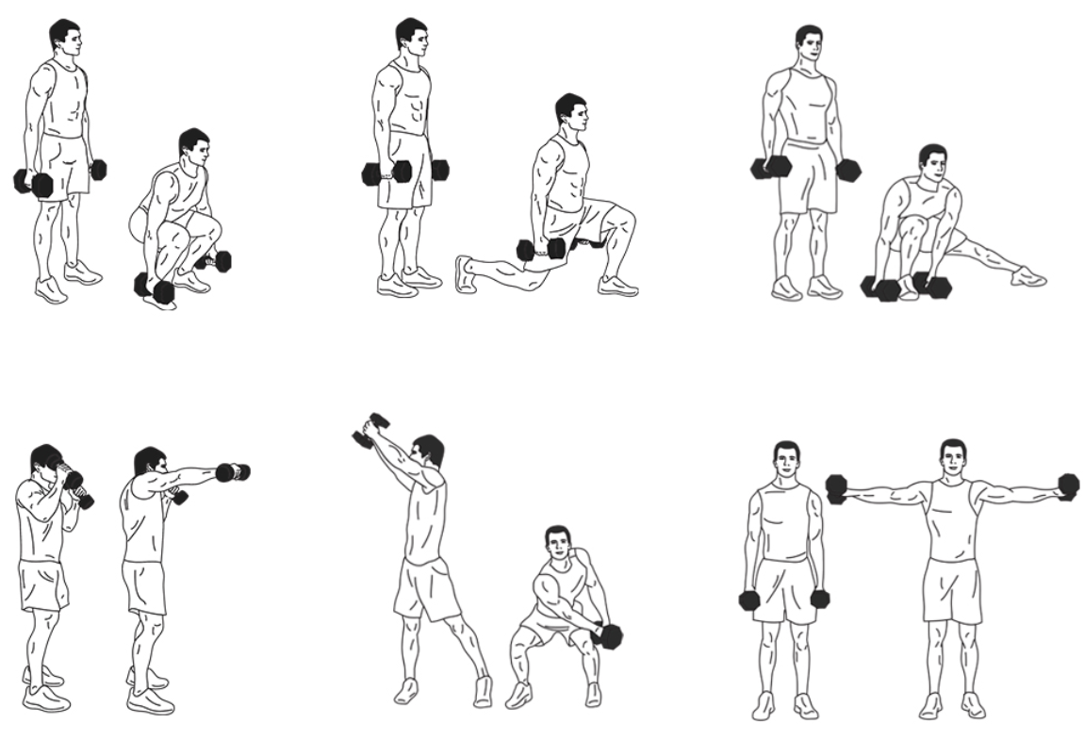
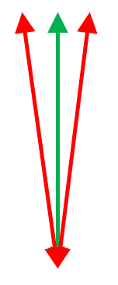
Objectives
01
Autonomy - Operate autonomously with a battery for more than 8h.
02
Compact Design – Compact and lightweight facilitating ease of use during exercise and to be attached to gym equipment.
03
Real-time Data Acquisition - Capability to collect motion data using accelerometer data in real-time and communicate to a host device using BLE.
04
Training NN - Train a NN model with a custom dataset for different exercise movements and with correct and incorrect labels.
05
Classification - validate the movement via a trained NN.
06
Feedback - provide real-time feedback to the user.
Notes:
Partir em dois slides e reduzir o texto
4 – use built in AI accelerater
BLE basta sigla

Slide 5
Related Works on Movement Recognition
Neural Networks for classification and movement recognition. Works were investigated in multiple areas such as:
01
Neural Networks applied to Sports
Wearable sensors to detect moves, using the IMU signal processing methods to classify specific activities. Examples like: jump frequency in volleyball, putt in golf, activity recognition in beach volleyball using a Deep Convolutional Neural Network - used also to avoid injuries, etc
02
Neural Networks applied to Health
The use of MCUs as edge inference devices for healthcare wearables, emphasize the need of TinyML solutions.
03
Generic Features
Use classification based on a set of generic features that were calculated from the sensor data to determine movements recognition.
Notes:
Shoulders, knees and the lower back are most prone to injuries due to the large loads that occur for example during a serve jump. tem imagem, mas wearable devices mostra-se mais eficiente para avaliar cada atleta
In this work, we investigate the different challenges and specifications trade-offs associated to existing hardware options, as well as recently developed software tools, when trying to use microcontroller units (MCUs) as inference devices for health and care applications. The paper also reviews existing wearable systems incorporating MCUs for monitoring, and management, in the context of different health and care intended uses. Overall, this work addresses the gap in literature targeting the use of MCUs as edge inference devices for healthcare wearables. Thus, can be used as a kick-start for embedding machine learning models on MCUs, focusing on healthcare wearables.
13 The emerging field of TinyML technology, deploying machine learning algorithms on resource-constraints embedded devices, can provide several advantages over cloud computing related to latency, power, and privacy.
Wearable IMUs contain a combination of accelerometer, gyroscope, and magnetometer sensors measuring along one to three axes. These sensors quantify acceleration, angular velocity, and the direction and orientation of travel respectively (

Slide 6
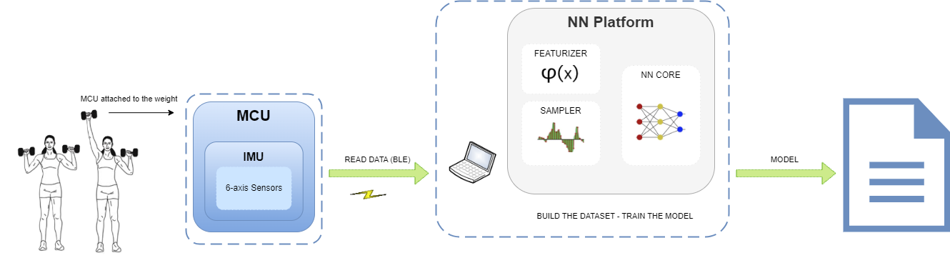
Solution Outline
01
Data collection and Model creation
Notes:
Problema a resolver
Esboço
Solution outline ( title)
IMU acc
MCU
RF/BLE
Antenas para ligar ao host (pc)
Plataforma resolve o que tinhamos para resolver -> solução completamente integrada
1 instância IMU para plataforma
2 – depois é que passa pelo acc
Diminuir texto
Detalhar o Seeed Studio XIAO nRF52840 Sense e os seus detalhes – fotografia
NN Platform - inferência
Explicar a solução
Embedded system for real-time motion recognition involves integrating an IMU, MCU and an OLED display.
The system collects motion data through the IMUs accelerometer. The MCU,
equipped with a NN implementation – previously trained, For training the NN, raw sensor data is transmitted to a computer - the host -via BLE - analyzes the motion data on-the-fly, categorizing movements as well or poorly executed, fast or slow, and correct or incorrect
trajectory. This information will be display using a LED or an OLED display,
depending on the equipment being used and the performed movement.

Slide 7
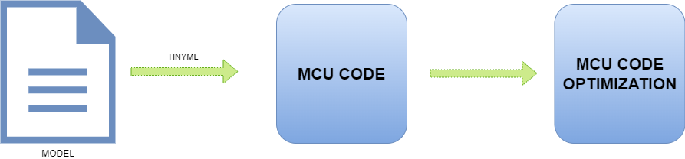
Solution Outline
02
MCU Code
Notes:
Problema a resolver
Esboço
Solution outline ( title)
IMU acc
MCU
RF/BLE
Antenas para ligar ao host (pc)
Plataforma resolve o que tinhamos para resolver -> solução completamente integrada
1 instância IMU para plataforma
2 – depois é que passa pelo acc
Diminuir texto
Detalhar o Seeed Studio XIAO nRF52840 Sense e os seus detalhes – fotografia
NN Platform - inferência
Explicar a solução
Embedded system for real-time motion recognition involves integrating an IMU, MCU and an OLED display.
The system collects motion data through the IMUs accelerometer. The MCU,
equipped with a NN implementation – previously trained, For training the NN, raw sensor data is transmitted to a computer - the host -via BLE - analyzes the motion data on-the-fly, categorizing movements as well or poorly executed, fast or slow, and correct or incorrect
trajectory. This information will be display using a LED or an OLED display,
depending on the equipment being used and the performed movement.

Slide 8
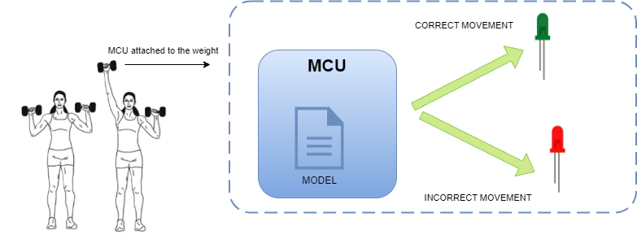
Solution Outline
03
Solution Outline
Notes:
Problema a resolver
Esboço
Solution outline ( title)
IMU acc
MCU
RF/BLE
Antenas para ligar ao host (pc)
Plataforma resolve o que tinhamos para resolver -> solução completamente integrada
1 instância IMU para plataforma
2 – depois é que passa pelo acc
Diminuir texto
Detalhar o Seeed Studio XIAO nRF52840 Sense e os seus detalhes – fotografia
NN Platform - inferência
Explicar a solução
Embedded system for real-time motion recognition involves integrating an IMU, MCU and an OLED display.
The system collects motion data through the IMUs accelerometer. The MCU,
equipped with a NN implementation – previously trained, For training the NN, raw sensor data is transmitted to a computer - the host -via BLE - analyzes the motion data on-the-fly, categorizing movements as well or poorly executed, fast or slow, and correct or incorrect
trajectory. This information will be display using a LED or an OLED display,
depending on the equipment being used and the performed movement.

Slide 9
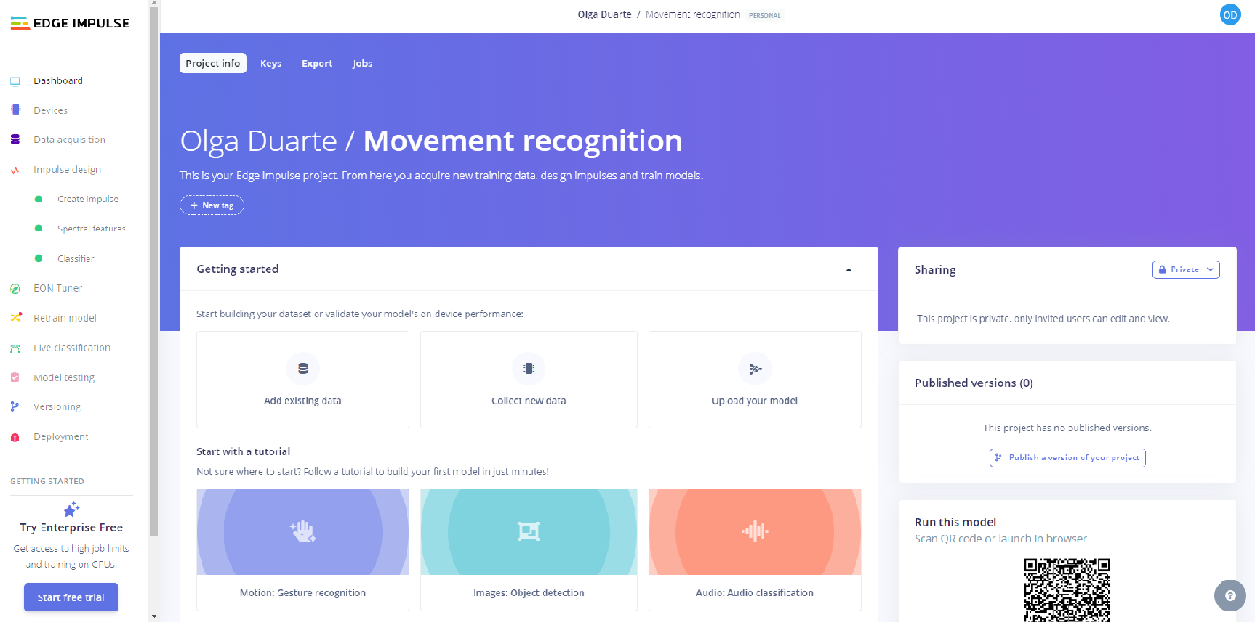
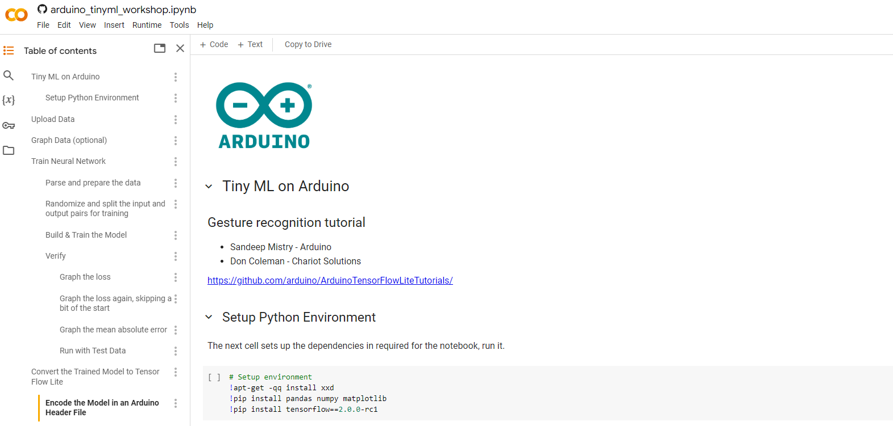
Low and No Code Platforms to train NN
Edge
Impulse
Development platform.
No cost.
Designed to run ML models on MCUs and other devices with only few kilobytes of memory.
TensorFlow Lite can be use.
No code platform.
No cost.
Integrates with small portable MCUs.
Uses TensorFlow Lite for training, optimizing, and deploying deep learning models to embedded devices.
Google
Colab

Slide 10
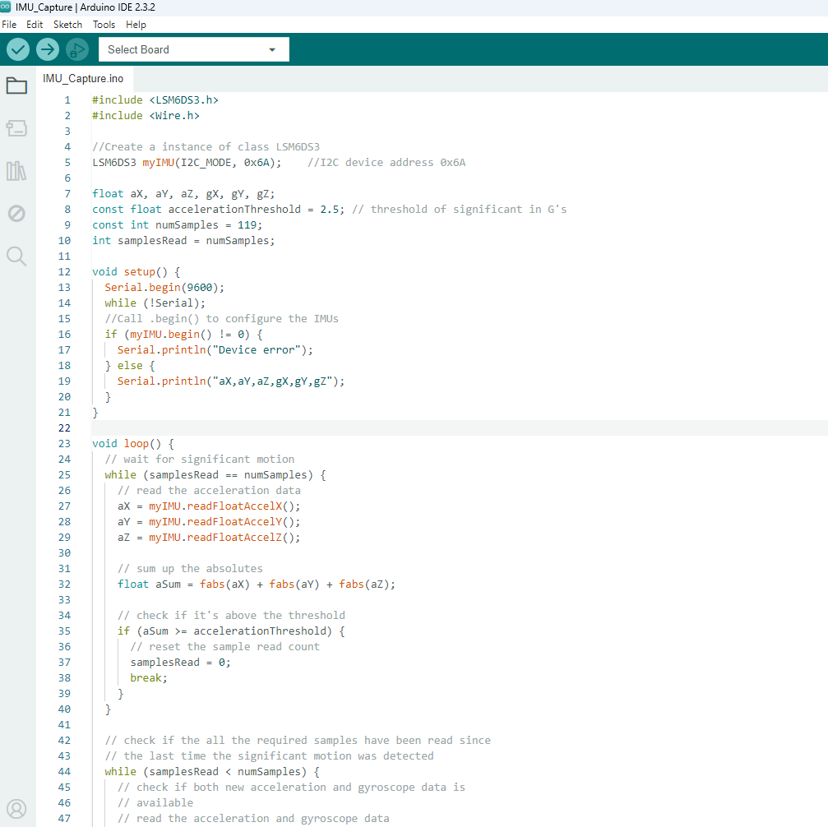
Relevant Technologies on Movement Recognition
01
Accelerometer & Gyroscope
Acc detects linear acceleration of devices, that is, the acceleration along an axis. While gyro detects the angular velocity, i.e, how fast the body is turning.
02
Ultra Low Power Embedded System
Capture, measure and report acceleration, orientation and other gravitational forces.
Bluetooth Low Energy
03
Wireless, low-power personal area network. Its goal is to connect devices over a relatively short range.

Slide 11
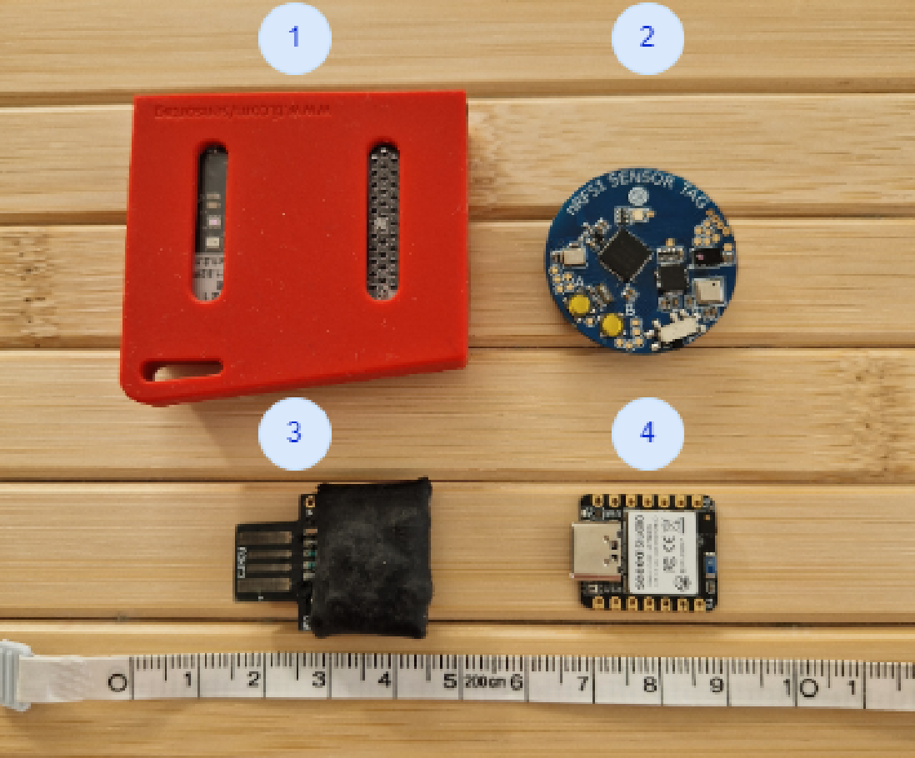
Ultra Low Power Embedded System
 | NRF51 Sensor Tag | Seeed Studio XIAO nRF52840 Sense | CJMCU Beetle | Texas Instruments TIDC-CC2650STK-SENSORTAG
Advantages | Low cost, 3 axis Accelerometer Sensor, BLE 5.0, Low Power Consumption Bluetooth. | Low cost, Low Power, BLE 5, Great documentation, not expensive, easy to start use and program, IMU with extra capabilities - like pedometer. | Low-power and extended-range Capabilities. | Advanced debugging and profiling Tools.
Disadvantages | Excluded due to the lack of examples and public documentation. | Pay more for the connectivity | Doesn’t have built-in Bluetooth capabilities. | Excluded due to the size, price and the learning curve of the software use to Develop.
Notes:
Enviar o datasheet <---
Comunicar sintese do que fiz
Take points / "sell" message
Trabalho de pesquisa, e os ensaios

Slide 12
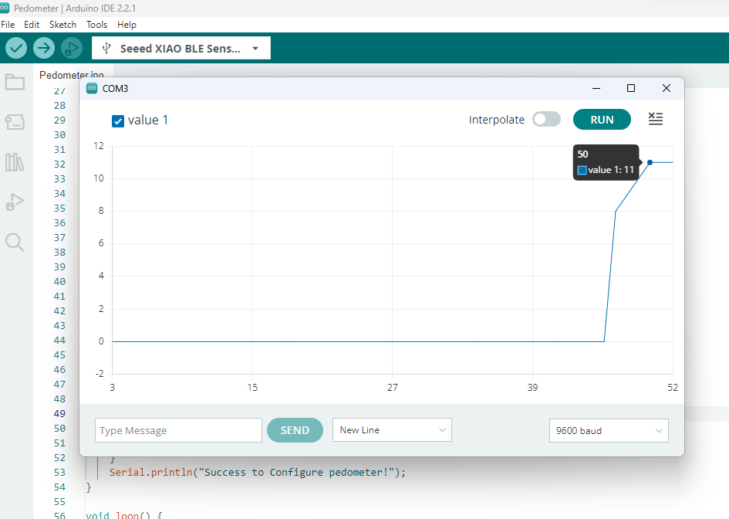
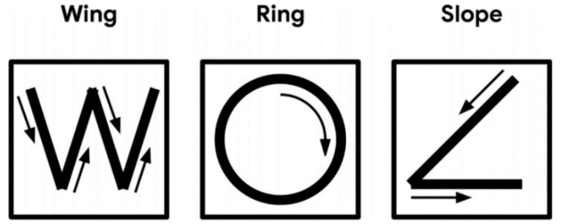
Preliminary Results​
01
Pedometer experience
Step counter, collecting the data from the sensor.
02
Magic Wand – Tiny ML
The goal was to analyze the 3-axis returns in different movements
Notes:
Enviar o datasheet <---
Comunicar sintese do que fiz
Take points / "sell" message
Trabalho de pesquisa, e os ensaios

Slide 13
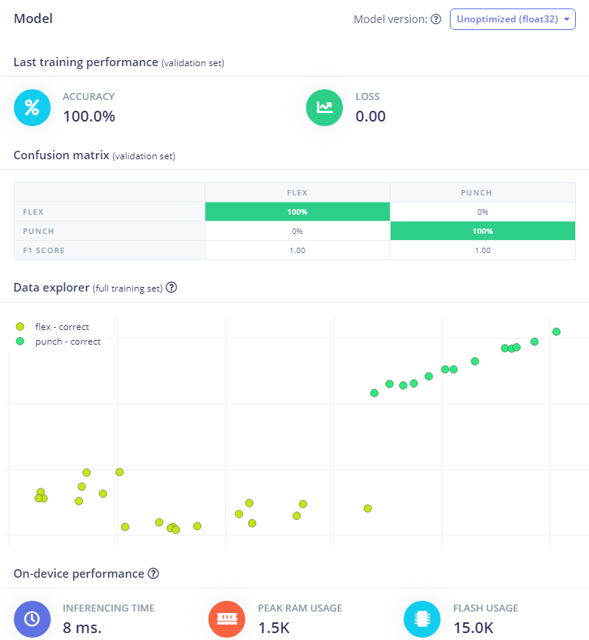
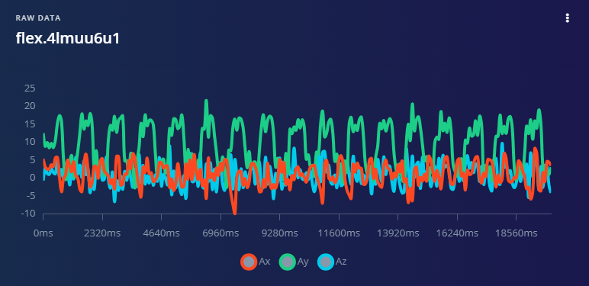
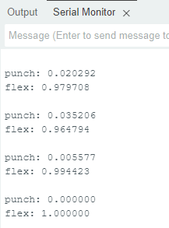
Preliminary Results​
03
Evaluation of TensorFlow Lite using the Edge Impulse Platform
The NN was trained using Edge impulse and the model was uploaded to the MCU using TensorFlow Lite (in Arduino).
Notes:
Enviar o datasheet <---
Comunicar sintese do que fiz
Take points / "sell" message
Trabalho de pesquisa, e os ensaios

Slide 14
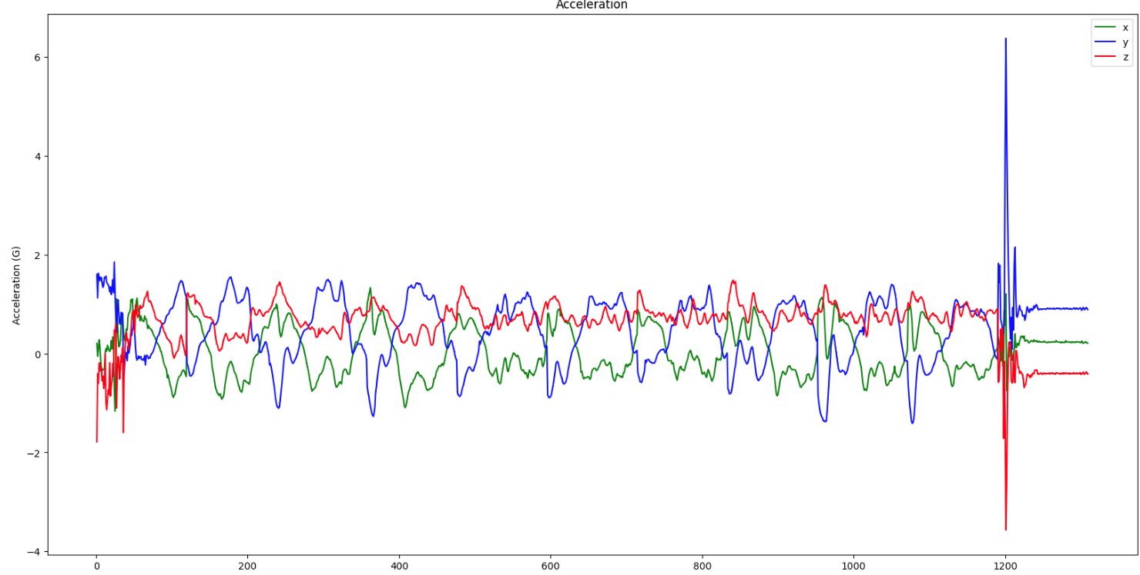
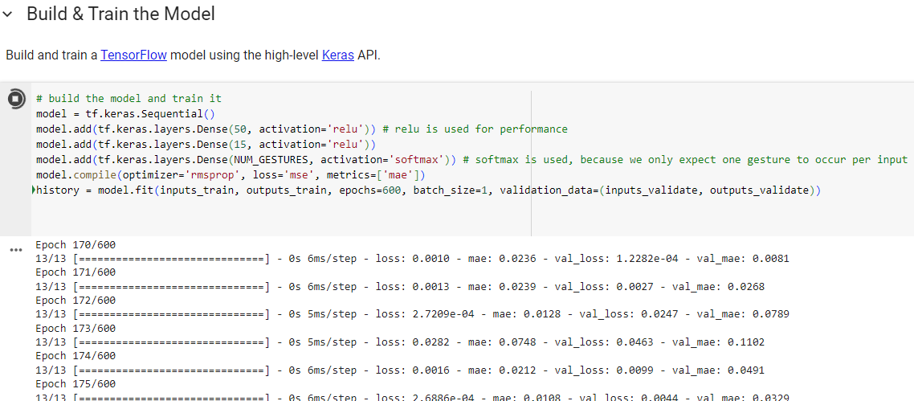
Preliminary Results​
04
Evaluation of TensorFlow Lite Using the Google Colab Platform
The NN was trained using a notebook (python code) in Google Colab and the model was included in the MCU using TensorFlow Lite.
Notes:
Enviar o datasheet <---
Comunicar sintese do que fiz
Take points / "sell" message
Trabalho de pesquisa, e os ensaios

Slide 15
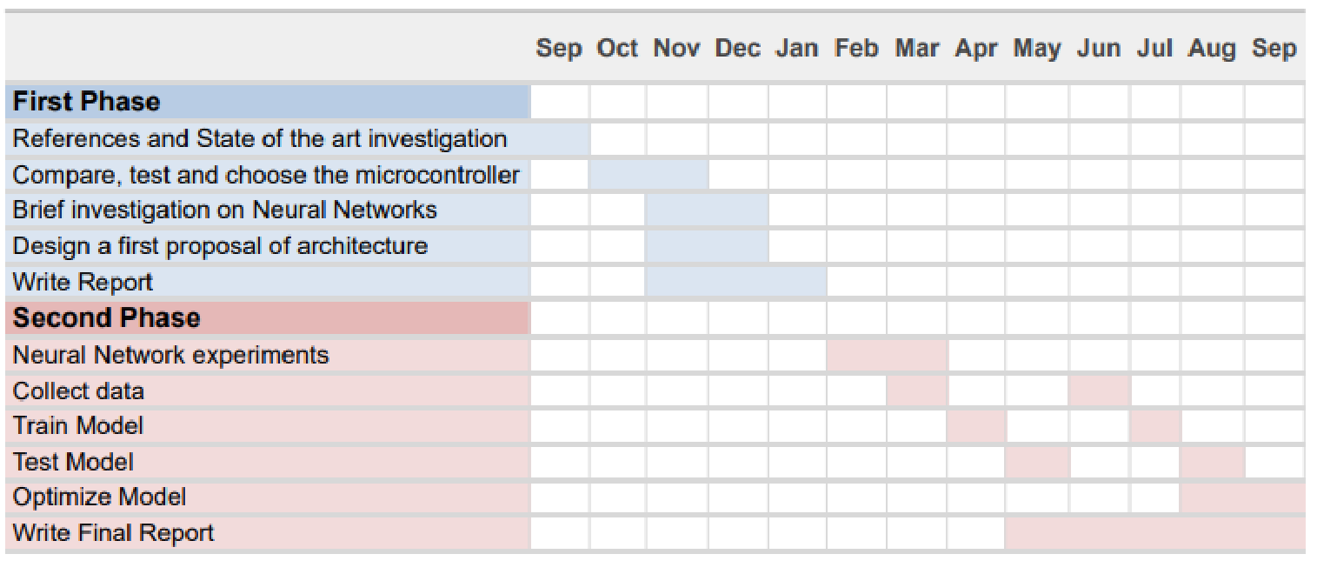
Work Plan
Here

Slide 16
Challenges and Limitations
Challenges
Limitations
Program a NN to run on the selected MCU
Ability of optimize the results of the NN Platforms used
Optimize the construction of the Model due to the limitations
Limited Storage
Improve battery usage
Limited RAM

Slide 17
Conclusions
When I accepted this challenge the first step was to analyze the state of the art and existing solutions and how I was going to compose my own.
A preliminary evaluation of the solution was found and explored.
Next Steps:
Improve the collect of the data.
Improve the Training of the NN.
Optimization of the network using TinyML (TensorFlow).
Notes:
Foi aceite o desafio para o determinado problema e fui ver o estado da arte e soluções existentes e como ía compor a minha
Avaliação preliminar da solução encontrada
Mas a ainda será feita a implementação da rede no micro, usando o tinyML (tensor flow)

Slide 18
THANK YOU!

Slide 19
Q&A

